Slide 1
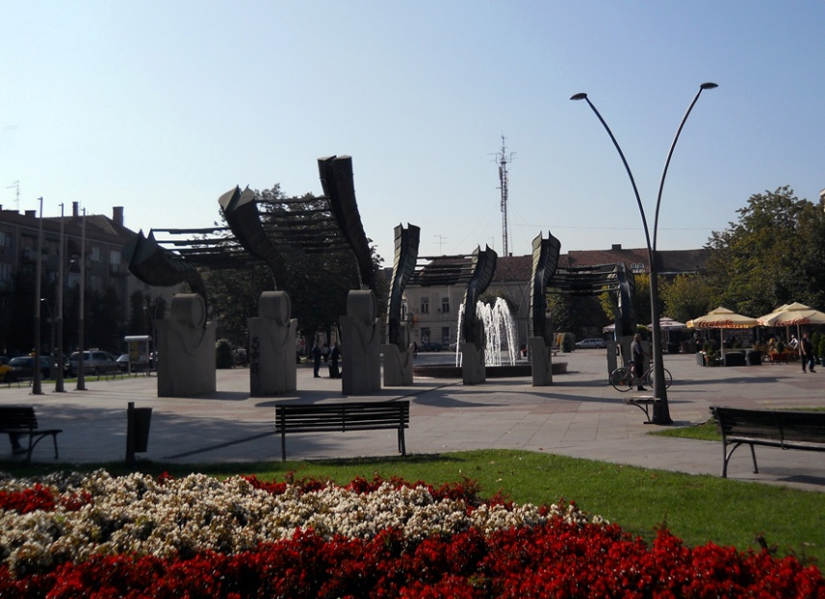


Ruma
Existing resources and investment potentials

Slide 2
VISION OF THE MUNICIPALITY OF RUMA 2030
Ruma is a well-developed regional center of Srem area, which in a sustainable way uses the available resources to achieve economic development and create favourable conditions that support economic activities and investments.
Our municipality also represents:
An environment with safe and satisfied citizens, equally included in all aspects of social life.
An environment in which all citizens have equal access to high-quality education, healthcare, as well as cultural and sports facilities.
An environment with efficient administration than recognizes the needs of its citizens.
An environment that has an inclusive social protection system.
An environment suitable for both younger and older population.
The municipality of Ruma takes special care of its natural potentials and evnironment, with developed communal and other infrastructure, which provides its citizens with access to clean water, clean air and preserved greenery.

Slide 3
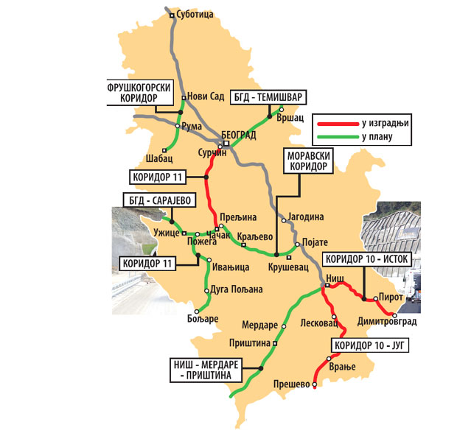
THE MUNICIPALITY OF RUMA
The Municipality of Ruma has an important geostrategic
position. It is situated in the center of Srem district, between
Danube and Sava, at the foothills of Fruška Gora. By its
surface of 582 km², the municipality takes the 13th place in
Vojvodina.
Population: 54,339
Number of communities: 17
Land use: 74% agricultural area, 13% forests, 13% other
Ethnic structure: 21 nationalities
Number of enterprises: 512
Number of entrepreneurs: 1,560
  Key Sectors:
Agriculture
Food processing
Automobile Industry (Automotive Components)
Metal Processing
Chemical Sector

Slide 4

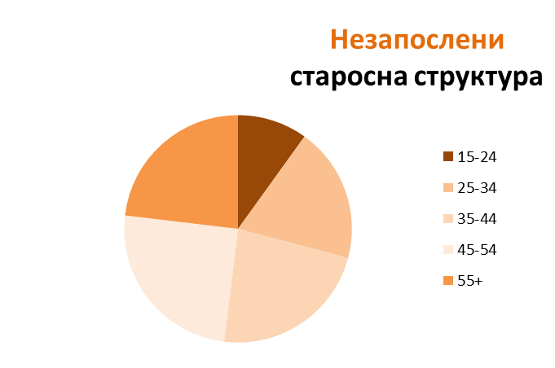

POPULATION
54
UNEMPLOYED AGE STRUCTURE
Number of residents: 54.339
.
2
Workforce
Employed
Total: 16.578
10% | 19% | 23% | 25% | 23%
458 | 886 | 1052 | 1150 | 1066
Unemployed
Total: 2.431
January 2022.
Average age: 42,7

Slide 5





WHY INVESTING IN THE MUNICIPALITY OF RUMA?
5 REASONS FOR INVESTING IN RUMA
Exellent strategic location
- close proximity to Belgrade, the international airport, major highways, and main railroads
A good return on investment and optimum cost-benefit
- the qualified workforce at competitive rates, fairly-priced land, and low construction costs
Straightforward construction permit procedures
Extremely attractive industrial locations with direct access to trans-European highway E-70
- 5 industrial zones
A special set of the local government incentives for the investors

Slide 6


BASIC INFORMATION
The main exporting countries | % of total exports
EU | 65,0 %
CEFTA | 15,8 %
Russia China Other | 3,9 % 3,8 % 10 %
GDP, 2021. | 53,317 billions of euros (EUR)
Agreement on eliminating double taxation, signed by 58 countries
The bilateral investment agreement made with 39 countries

Slide 7
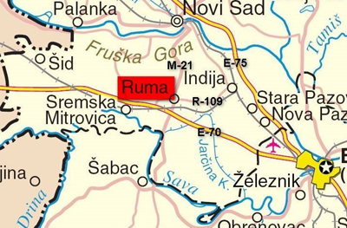

THE INTERSECTION OF MAIN EUROPEAN ROADS
construction started in 2019. The modern road that will connect Ruma and Loznica with a total length of 77 km will include three spatial units: the Rume section, the bridge over the Sava River and the Šabac - Loznica section.
Key traffic networks:
highway Е-70;
the main highway M-21(State Road IB Class No.21) Novi Sad-Šabac-Sjenica;
railway Belgrade-Zagreb-Vienna (27 км);
vicinity of the harbor in Sremska Мitrovica (15 км);
vicinity of the harbor in Šabac (35 км);
vicinity of the international airport Nikola Тesla (35 км).
Roadway Ruma-Šabac-Loznica
Construction started in 2019. The modern road that will connest Ruma and Loznica with a total lenght od 77 km will include three area units: the Ruma section, the bridge over the Sava riverand the Šabac - Loznica section.

Slide 8

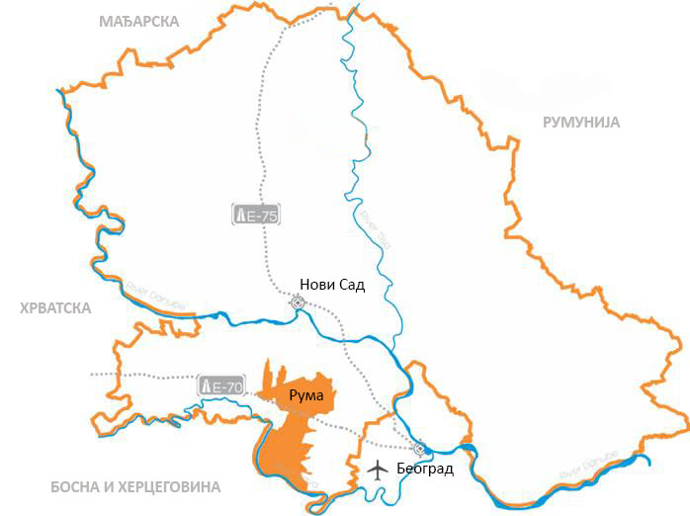



















STRATEGIC POSITION
Ruma- ukupna površina 582 km
Срб
Distance From Borders
HUN
CRO
ROM
BUL
BIH
Река Тиса
Distance From Highway
Река Дунав
Distance From Airport
Река Дунав
Belgrade
Оsijek

Slide 9

Quality Work Force
* 4 secondary schools
* 12 elementary schools
* Between two greatest university centres :Belgrade (50 km) and Novi Sad (35 km)
* Available, good quality and experienced work force
* Experience in certain domains
* Competitive wages

Slide 10

High school | Major | #students | #graduates
Grammar School (Gimnasium) | General | 165 | 49
 | Humanities and languages | 217 | 52
Specialized | Economics | 115 | 26
 | Legal business technician | 123 | 30
 | Fashion designer | 81 | 21
 | Hairdresser | 78 | 24
 | Cooker, Waiter | 59 | 22
Agricultural | Agricultural technician | 85 | 29
 | Veterinarian | 111 | 27
 | Baker | 19 | 9
 | Butcher | 18 | 9
 | Dental nurse technician | 30 | /
EDUCATION

Slide 11
High school | Major | #students | #graduates
 | Computer Systems | 112 | 27
 | Motor vehicles | 45 | 0
 | Electro-energy automatics | 48 | 23
 | Computer Design Mechanical Technician | 106 | 27
Tecnical | Electrician | 6 | 0
 | Servicer of thermal and cooling devices | 5 | 0
 | Electrical installer | 16 | 11
 | Refrigeration and Air-Conditioning mechanic | 12 | 12
 | Locksmith-welder | 30 | 10
 | Motor vehicles mechanic | 15 | 8
EDUCATION

Slide 12
INCENTIVES
REPUBLIC | Funds are allocated for investment projects in the area of production and service sectors (international commerce), agriculture, and fishing industry. The allocated funds make up to 50% of the invested funds, based on the investment value or the two-year employees' gross earnings.
PROVINCIAL | System Support | Development agency of Vojvodina Capital Investment Administration of AP Vojvodina Guarantee Fund of AP Vojvodina Development Fund AP Vojvodina
 | Support for developmental economic facilities | Provincial Secretariat for Economy and Tourism Provincial Secretariat for Agriculture, Water Management, and Forestry Provincial Secretariat for Regional Development, Interregional Cooperation, and Local Self-Government
LOCAL GOVERNMENT | Greenfield – a lower price than the market one or free of charge one
 | Local taxes

Slide 13



MUNICIPALITY INCENTIVES & FEES
Account Manager
Appointed to each investor:
* assistance in administrative procedures
* liaison with relevant institutions
Accelerated Procedures
For issuing building permits
* 2 days from submitting the required documentation
Communal Fee
* depending on the number of new employers
Land Price Discounts
* depending on the number of new employers
* price for 8 euro per m²

Slide 14



ENERGETIC POTENTIAL
GAS
ELECTRICITY
Municipality is gaslfied | 100 %
Local Pipeline length | 514 Km
Pressure on main pipeline 6-12 bar Pressure on local pipeline 0-4 bar
No. of distribution substations - 10/x 35/x ; 10(20)/04 | 305
Total Power | 256.310 kVA
Total Network Length
Medium voltage network | 275 Km
Low voltage network | 336 Km
Energy supplied in 2013/14 | 177.572 MWh
Avaliable capaclties 110/x: 94.500 kVA 5/x: 32.000 kVA 10(20)/0.4: 129.810 kVA
FARMLAND
Total Land | 58.206 ha
Agricultural Land | 42.970 ha
Arable Land | 41.764 ha
Most common crops Maize, wheat, soy * Crop residue: 105,000 per year

Slide 15

REVIEW OF TAX RATES
PROFIT TAX
INCOME TAX
VAT – standard rate
Serbia | 15 %
Romania | 16 %
Poland | 19 %
Czech Republic | 19 %
Croatia | 10-18 %
Slovakia | 15-21 %
Slovenia | 19 %
Serbia | 10 %
Czech Republic | 15 %
Romania | 16 %
Slovakia | 19-25 %
Poland | 18-32 %
Croatia | 12-40 %
Slovenia | 16-50 %
Serbia | 20 %
Romania | 19 %
Slovakia | 20 %
Czech Republic | 21 %
Poland | 23 %
Croatia | 25 %
Slovenia | 22 %
5 working days a week – 40 hours per week : (37.5 hours net) 30 minutes break per day
Vacation Minimum 20 days per year Holidays Non-working days during the year 11-20 | Overtime and night shift 26% bonus on a basic salary National holidays 110% bonus on a basic salary | A fixed-term contract Maximum of 2 years Trial period Maximum of 6 months | Minimum monthly Salary NET 170 € Total cost 230 €
Social contributions:
Pension and disability insurance
Health Insurance
Unemployment Insurance
Employee Employer
14% 11%
5,15% 5,15%
0,75% /

Slide 16



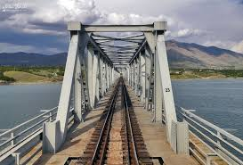



INFRASTRACTURE
ROADS
WATER SUPPLY
Highway E-70 length | 27 Km
Regional road network | 86 Km
Local road network | 119 Km
River Sava length | 30 Km
Port in Sr. Mitrovica distance - 16 Km Port in Šabac distance - 36 Km
Irrigation/drainage network | 1.109 hectares
SEWAGE SYSTEM
Sewage system | 100 %
Sewage network | 100 Km
* Water purlfier in use
RAILWAY
Railway network length Belgrade - Zagreb - Viena | 27 Km
Axial pressure | 22,5 t

Slide 17


CONSTRUCTION PERMIT PROCEDURE
Laying down the location conditions for the cadastre parcel suitable for construction - since the day of obtaining all specific terms, permits, and other documents.
Phases & Timeline
Upon receiving an investor’s request, the consolidated construction permit procedures are conducted in the following phases.
In total: 28 working days
Working days
5
No Later than:
Based on construction work registration, issuing the verification for the application receiving without delay, verifying that the complete documentation has been submitted.*/**
Granting the construction permits - since the day of the request submission.
Working days
5
No Later than:
Working days
Upon receiving the application.
5
No Later than:
Working days
Granting the final approval (exploitation permit) upon receiving the submitted request.
3
No Later than:
Working days
5
No Later than:
Working days
Registering in the cadastre.
5
No Later than:
Working days

Slide 18


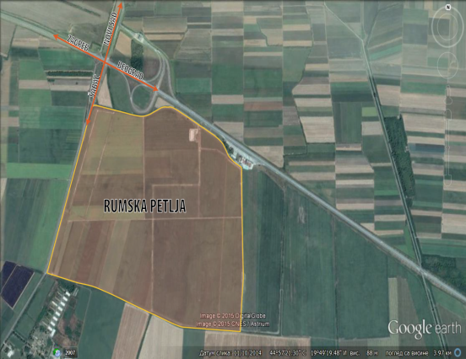
GREENFIELD LOCATIONS
Location 1
Industrial zone Rumska petlja
Surface area : 238 hа
Available : 153 hа
Individual plots : 1-50 hа
Purpose : industrial
Property : municipality
Description:
*close to Highway-70 and railway
*plan to make sewage sistem
Present companies:
HealthCare Europe
CG Food Europe (Wai Wai)
Rumekon Doo
Gresto
Srbijaautoput
Location 2
Rumska petlja “West”
Surface land : 767.199м2
Location 3
Work zone ,,South 2”
Surface land : 836.589 м2
Surface of objects : 2629 м2
Location 4
Work zone ,,West”
Surface land : 1.950.000 м2
Surface of objects : 970.000 м2
Location 5
Work zone ,,East 2 “
Surface area : 425.000 м2
Surface of objects: 400.000 M2
sale
rent

Slide 19
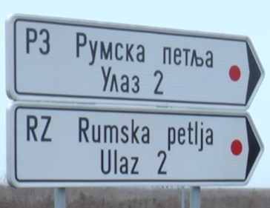
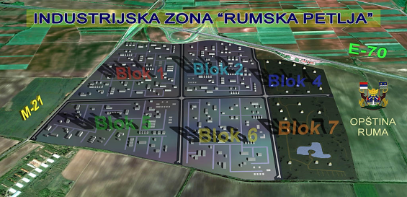
Work zone
RUMSKA PETLJA
238 ha
Intersection of roads: Е-70 highway Belgrade-Zagreb
and the first class state road M21 Novi Sad-Šabac
Parcels size from 1 ha to 50 ha
Electric power network 14 MW (there is a possibility for connection to the transmission line 20 kB)
Magistral water supply network located 250m from the
parcels, capacity 200 l/per second
Gas network
Access roads
Public lighting

Slide 20
Rules and conditions for planning and building on construction plots in blok 1 of the work zone Rumska petlja
Within the work zone "Rumska petlja", in block number 1, construction plots can be formed - potential locations for construction of work complexes, with areas from 1.5 to 5.1 ha.
From existing plots, it is possible to form new construction plots, all by the parameters set out in the plan.
On the building plot, it is possible to build production storage facilities and supporting facilities that operate as well as facilities for infrastructure purposes.
Secondary and tertiary activities are permitted as well as various service activities
Construction of a waste storage facility as a facility where the activity of storage of waste and treatment and disposal/disposal facilities for hazardous waste, as well as underground reservoirs, is prohibited, due to the proximity of the source
The occupancy index on the plot is 50% and the construction index is 2.0.
Maximum number of production, processing and auxiliary facilities is P + 0, galleries are possible, exceptionally P + 1 if technology requires it.
For buildings for administration and similar purposes, the maximum number of floors is P + 3, but the height of the building does not exceed the height of 16.0 m.

Slide 21


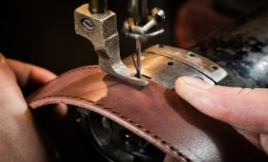


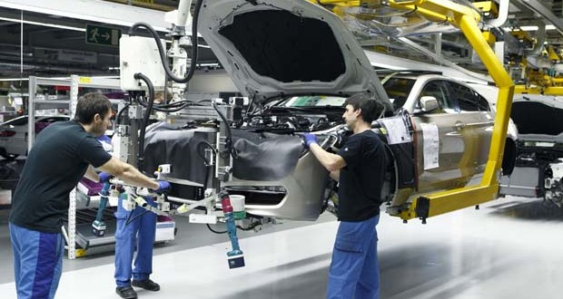
KEY SECTORS
Opportunities for investment
AGRIBSINSS
Leather and footwear
industry
TOURISM
TOURISM
CHEMCAL INDUSTRY
Agribusiness
Textile industry
ICT
CONSTRUCTION
TOURISM
METAL PROCESSING
LOGISTIC CENTER
Automotive industry
Tire industry

Slide 22
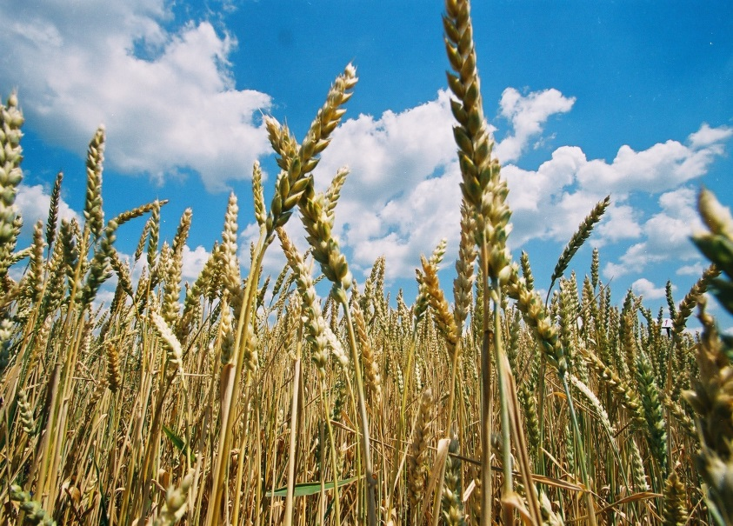
AGRIBUSINESS
41.000 ha of fertile arable land
Main advantages:
Arable land 41,700 ha; Pastures 720 ha; Orchards 691 ha; Meadows 245 ha; Vineyards 183 ha; Gardens 10 ha.
A wide network of potential local suppliers: 7000 small farms – a number of agricultural cooperatives.
Agri-association: promoting & implementing E-agriculture.
Grain storage capacities: 71,500 t.
Agricultural high-school: a continuous supply of an educated workforce.
Investment opportunities: Fruit & Vegetable processing, Meat & Dairy production.
Arable land 41.000 hа
maize | 51 % | vegetables | 6% | sunflower | 3 %
wheat | 21 % | fodder | 5% | tobacco | 1 %
soy | 8 % | sugar beet | 3% | barley | 0,7 %
Livestock count
cows | 1.207 | sheep | 4.962 | poultry | 224.758
cattle | 5.024 | goat | 1.783 | brоilers | 146.000
sows | 5.305 | pigs | 61.310 | hens | 42.798

Slide 23
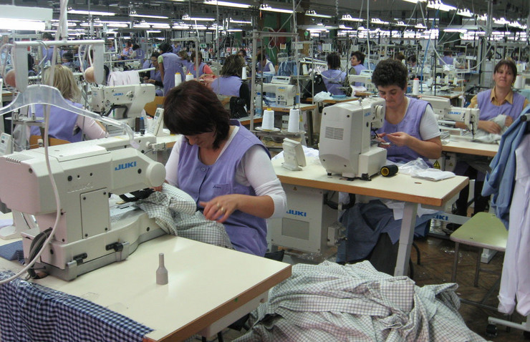
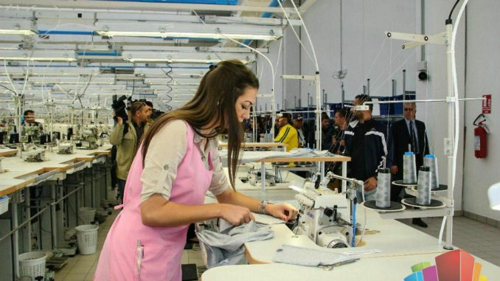
TEXTILE INDUSTRY AND LEATHER AND FOOT
INDUSTRY
Half-century tradition
Main advantages :
Skilled workforce at competitive rates
Textile high-school – a constant influx of qualified workers
Reputable companies with a long-established tradition
Leather Factory Ruma - leather processing since 1936;
Footwear Factory Fruska Gora - footwear production since 1948;
Apparel Factory Kluz - Srem - apparel production since 1947.
Companies and partners:
Adriana Tex (Calzedonia) – swimwear (Italy/Croatia)
Falc East – children's footwear (Italy)
Selia (Insert)- footwear (Serbia)
Dag-Co – leather (Serbia)
Luxury Tannery – fur and leather (Italy/France)
HealthCare Europe – memory foam (China)

Slide 24
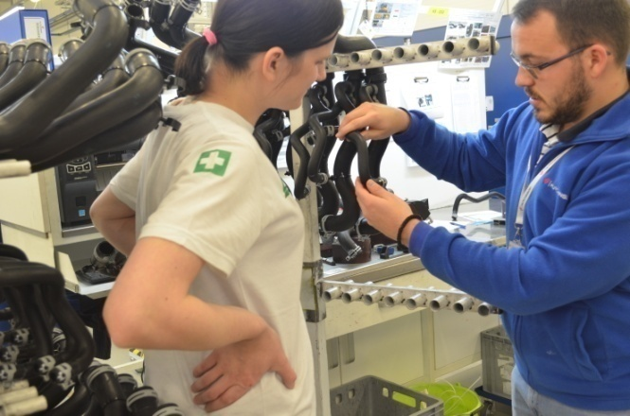

AUTOMOTIVE COMPONENTS
Ideal strategic position
MAIN ADVANTAGES :
A popular choice for foreign companies dealing in automotive component manufacture
Technical high-school - supplying the companies with highly-skilled workers, fulfilling the industry standards
Great potential for export-oriented production since FTAs and perfect strategic position enabling international commerce, logistics, and supply chain
Full and ongoing support for investors and key sectors
A number of successful foreign companies:
ALBON - manufacture of turbines, electric motors, generators (UK)
MITAS TRELLEBORG- production of tires for agriculture machines (Sweden)
HUTCHINSON - rubber hoses for liquids in car engines (France)
Land ownership:
municipal

Slide 25
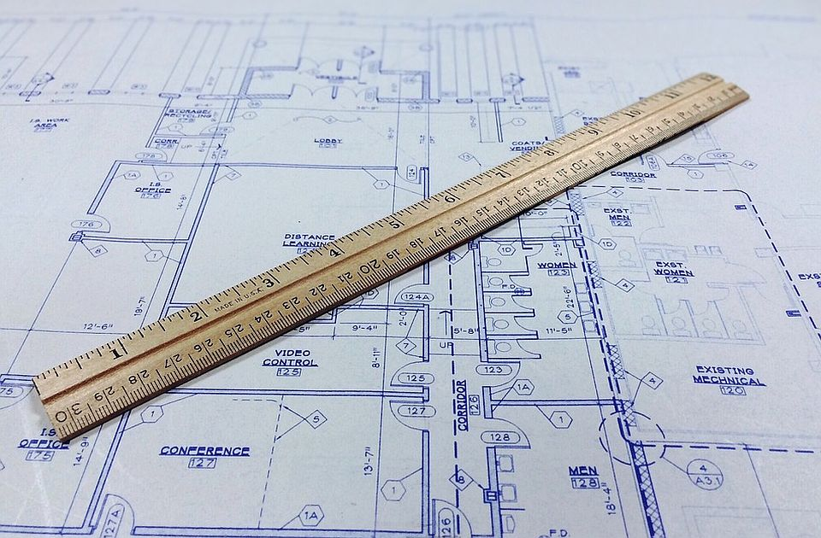
THE BEST WORKING PRACTICES
The Commission for the election of best practices in the area of good governance principles implementation at the local level has made the decision on the winner award for cities, communities, and municipalities that contributed the most to the development and implementation of good governance principles within their territory in 2018.
In the section of "Transparency and Public Participation in the Work of Local Self-Government", the Municipality of Ruma won the first prize.
The effectiveness of local government in granting construction permits is a great example of the best business practice. The Municipality of Ruma has received a large number of requests for construction permits that are responded to quickly and positively.
The award was presented by the Ministry of State Administration and Local Self-Government, and the Standing Conference of Towns and Municipalities - Association of Cities and Municipalities of Serbia (SCTM) as a part of the project "Improving good governance at the local level."

Slide 26













FOREIGN COMPANIES IN RUMA

Slide 27

TOP 15 Employers
Companies | Country | Number of employees (january 2022.)
HEALTHCARE EUROPE | China | 1100
HUTCHINSON | France | 841
MITAS - TRELLEBORG | Sweden | 580
DAG-CO | Serbia | 355
CABLEX-S | Slovenia | 320
SELIA (INSERT) | Serbia | 200
CALZEDONIA | Italy | 225
FALC EAST | Italy | 265
ALBON | United Kingdom | 255
LUXURY TANNERY | France | 184
FRIGO ŽIKA | Serbia | 215
WAI WAI (CG Food Europe) | Nepal | 227
MATIS MEBL | Serbia | 120
ANDRIJAŠEVIĆ | Serbia | 86
RUMEKON | Serbia | 70
UKUPNO: |  | 5043

Slide 28

Your partner in Ruma
Thank You For
Your Attention
The Municipality of Ruma
Glavna 155, Ruma
Department for local and economic development
ruma.razvoj@gmail.com
www.ruma.rs

